Slide 1
Facebook Project – Your Name
You can complete one or more of the following pages on a historical figure.
Insert the historical figures picture and name on each page you select to complete.
INFO - Fill out as if you were that historical person.
FRIENDS – Type in the name of the people who would have been involved with the historical figure. Put a picture or symbols for each friend. This could include people who were not their friends.
WALL - This should be a time line of some important event. Pick one or more of the historical figures friend to set the time. It can be in years. Great place to use people who did not agree with them.
PHOTOS –Use different pictures that illustrates aspects of their lives – family, important sites, etc.
NOTES – Copy of a speech or short explanation of something that was important in their lives.
Facebook can help you connect and share history of people’s lives.
All about Me Museum:
This could be use by students to document their lives and likes.
SPECIAL NOTE: All pictures and facts must be end noted.
Contact rmcgee@ewsc.k12.in.us if there is a problem with this file.

Slide 2
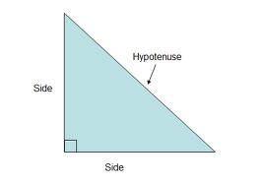
Right Triangle
> Info
Birthday:
I am:
Education:
Hometown:
Work:
Interested in:
Philosophy:
Places I have traveled :
Other :
I was born by bisecting a rectangle at opposite corners back before dates were recorded.
Always Right .
I’m exist in all aspects of education, starting with kindergarten with shapes and all through high school and college in geometry and trigonometry.
(1)
Greece (Pythagoras brought me to life around 500 BC)
I work in theorems beginning with the angle sum theorem, but am most know for the Pythagorean Theorem.
Rulers, drafting, line dancing, billards,and traveling to the Bermuda Triangle
Its all about the angles
I have traveled into the three dimensional arena and become part of triangular prisms and triangular pyramids.
I can be combined with two 45 degree angles or a 30 & 60 angle to become even more special

Slide 3
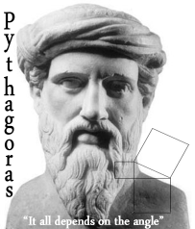
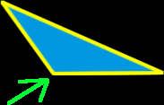
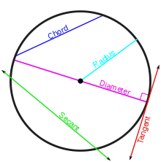
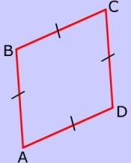
Right Triangle
> Friends
Pythagoras – founder & friend (2)
(1)
Obtuse Triangle – cousin (3)
Rectangle – friend (4)
Circle – enemy (5)
Rhombus - friend (6)
Delete pictures and put in pictures of people they work with in their lives. They could have been someone who did not like them.

Slide 4
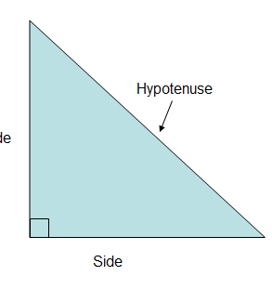
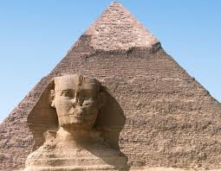
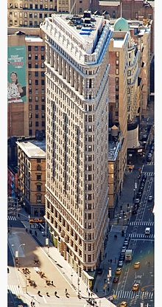
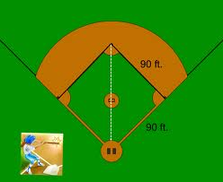
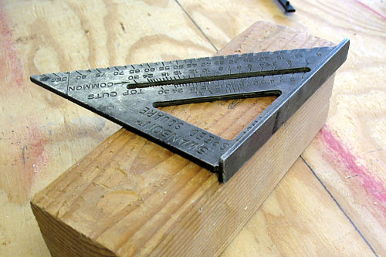
Right Triangle & Triangles
> Photos
Me in a sign
(10)
Pyramid & Sphinx (8)
(11)
squaring tool (7)
The Flatiron Building in New York (9)
Calculate distance from home to 2nd base

Slide 5
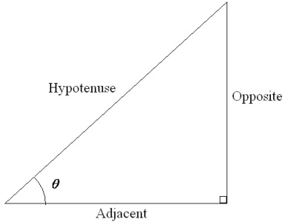
Right Triangle
> Wall
You should be glad that I made you famous, it really took we quite some time to prove the Pythagorean Theorem
July 495 B.C.
(2)
Its not that I don’t appreciate it, but why did you have to name my longest side which is opposite the right angle the “Hypotenuse”? Do you know how much fun students make of that name? Most can’t even pronounce it.
July 495 B.C.
(14)
The word hypotenuse is actually from the Greek language, remember the United States hasn’t been discovered yet. It is made up of hypo", meaning "under" + "teinein", meaning "to stretch". Hence, it sort of means "under tension". (12)
(2)
I guess you’re right, it could be worse, at least right triangle is easy to spell. Just think about my cousin. Isosceles triangle, people can’t even spell his name.
(14)

Slide 6
> Notes
Title Special Theorems involving the Right Triangle
Date:
Since this is a 30-60-90 right triangle, we know that the sides exist in the proportion 1:sqrt(3):2. The shortest side, 1, is opposite the 30 degree angle. Since side X is opposite the 60 degree angle, we know that it is equal to 1*sqrt(3), or about 1.73. Finally, side Y is opposite the right angle, and it is twice the shortest side, or 2. (12)
In algebraic terms, a² + b² = c² where c is the hypotenuse while a and b are the legs of the triangle (12)
Theorem. In an isosceles right triangle the sides are in the ratio 1:1:. (13)
Leg Theorem (Side/Angle/Side) (13)
The Leg-Acute Angle Theorem is a rule specially designed for use with right triangles. (If anyone cares, it is actually the Angle-Side-Angle rule.) It states if a leg and an acute angle of one right triangle are congruent to the corresponding parts of another right triangle, the two right triangles are congruent. (13)

Slide 7
Bibliography
http://www.google.com/imgres?q=right+triangle&um=1&hl=en&tbm=isch&tbnid=757Qt1ixgQPnmM (rt triangle)
http://sc5gz8e.edu.glogster.com/false
http://www.google.com/imgres?q=obtuse+triangle&um=1&hl=en&sa=N&tbm=isch&tbnid=ZTGqYmKT1Zl5WM
http://www.google.com/imgres?q=rectangle&um=1&hl=en&tbm=isch&tbnid=sSgbgAGKHJG2sM:&imgrefurl=http://www.mathsisfun.com/quadrilaterals.html&docid=KQi2yZ6V5hrmTM&imgurl=http://www.mathsisfun.com/images/quadrilateral
http://www.google.com/imgres?q=circle&um=1&hl=en&tbm=isch&tbnid=-Kt-wy-aIQKJ8M:&imgrefurl
http://www.google.com/imgres?q=rhombus+shape&um=1&hl=en&tbm=isch&tbnid=Tyk5qUYq4ZHQOM
http://www.google.com/imgres?q=right+triangle+in+real+life&um=1&hl=en&tbm=isch&tbnid=BEGbVF6FV_yXbM (rt square tool)
http://www.google.com/imgres?q=pyramids&um=1&hl=en&tbm=isch&tbnid=_GQYZtqnVqhpDM:&imgrefurl=http://www.culturefocus.com/egypt_pyramids.htm&docid=Z1wi0vA0SA_8tM&imgurl=http://www.culturefocus.com/egypt/pictures/sphinx
http://en.wikipedia.org/wiki/Triangle#Triangles_in_construction (building)
http://www.google.com/imgres?q=yield+sign&um=1&hl=en&tbm=isch&tbnid=U3SqZzh5RneGHM:&imgrefurl
http://www.google.com/imgres?q=pythagorean+theorem+baseball+park&um=1&hl=en&tbm=isch&tbnid=_N2nrsFs0odJmM:&imgrefurl
http://mathforum.org/library/drmath/view/57748.html
http://www.cut-the-knot.org/pythagoras/index.shtml
http://www.google.com/imgres?q=right+triangle&start=95&um=1&hl=en&addh=36&tbm=isch&tbnid=pH_vAwUrEDVfYM:&imgrefurl
111om/false/hhttp://sc5gz8e.edu.glogster.com/false/ttp://sc5gz8e.edu.glogster.com/false/http://sc5gz8e.edu.glogster.com/false/

